Slide 1
DATA encryption for transmissions with image Steganography technique
CAPSTONE PROJECT
Presented By: Mohammed Abdul Rahman
Student Name : Mohammed Abdul Rahman
College Name & Department : MVSR Engineering College, ECE

Slide 2
OUTLINE
Problem Statement
Technology used
Wow factor
End users
Result
Conclusion
Git-hub Link
Future scope

Slide 3
Problem Statement
With the rapid advancement of technology, smart devices increasingly rely on vast amounts of collected data to function effectively. However, this raises concerns about what data is being collected, where it is stored, and how it is used. Devices such as smartphones continuously gather sensitive information from search engines, social media, banking apps, and location services, making data privacy a critical issue.
If such data falls into the wrong hands, it can lead to privacy breaches, financial fraud, and identity theft. Therefore, securing personal and confidential information is of utmost importance, particularly in defense, finance, and private communications.
This project aims to implement a steganographic encryption and decryption method, where secret messages are embedded within images by subtly modifying pixel values. This technique ensures that sensitive information remains hidden in plain sight while preserving the image’s visual integrity. To enhance security, the system will also include password protection, allowing only authorized users to decrypt and retrieve the original message.

Slide 4
Technology used
Technologies
Steganography – Hiding data inside images by modifying pixel values.
Cryptography (AES Encryption) – Encrypting and decrypting messages using the AES (Advanced Encryption Standard) algorithm.
algorithm.
Image Processing – Using OpenCV to read, modify, and save images.
File Handling – Reading and writing encrypted messages, passwords, and IVs to external files.
Python Programming – Implementing encryption, decryption, and steganography logic.
Libraries used
OpenCV (cv2) – Used for reading, modifying, and saving images.
NumPy (np) – Helps in handling image data as arrays for pixel manipulation.
hashlib – Used to generate a SHA-256 hash from the password to create a strong encryption key.
pycryptodome (Crypto) – Provides AES encryption and decryption using CBC mode.
os – Handles file operations like saving and opening encrypted images.

Slide 5
Wow factors
This project combines cryptography with steganography, making the hidden message secure even
if someone suspects its presence. Basic steganography only hides information, while this approach
ensures confidentiality and integrity of the data.
AES Encryption for Enhanced Security
Traditional steganography only hides data in an image, making it detectable if analyzed.
This project encrypts the message before embedding it, ensuring even if extracted, it remains unreadable without the correct password.
Password-Protected Retrieval
Standard steganography allows anyone with knowledge of the technique to extract hidden data.
This system requires a password to decrypt the message, adding an extra layer of protection.
Use of Cryptographic Hashing
The password is converted into a 256-bit key using SHA-256, making brute-force attacks harder.
Basic steganography lacks such cryptographic reinforcement.
CBC Mode for Secure Encryption
Uses AES-CBC (Cipher Block Chaining) mode, which ensures that even identical messages appear different when encrypted.
Basic steganography stores raw data without such security mechanisms.
Protection Against Steganalysis
Since data is encrypted before embedding, statistical analysis tools for detecting hidden messages in images become less effective.
Plain steganography leaves patterns that could be recognized through analysis.

Slide 6
End users
Cybersecurity Professionals
Use steganography and encryption for secure data transmission in sensitive environments.
Prevents interception and unauthorized access to critical information.
Government & Defense Agencies
Secure classified communication by embedding encrypted intelligence within images.
Useful in espionage and covert operations where secrecy is crucial.
Financial Institutions & Banks
Protect sensitive financial data from cyber threats.
Secure transaction details, authentication codes, or confidential communications.
Journalists & Whistleblowers
Hide crucial information to avoid censorship and protect sources.
Ensures safety while leaking sensitive information to the public.
Privacy-Conscious Individuals
Safeguard personal conversations, passwords, or financial data from hackers.
Prevent surveillance by embedding confidential information in ordinary images.
Intellectual Property Holders
Protect copyrighted documents, trade secrets, and proprietary algorithms.
Securely share sensitive business information without exposure to competitors.

Slide 7
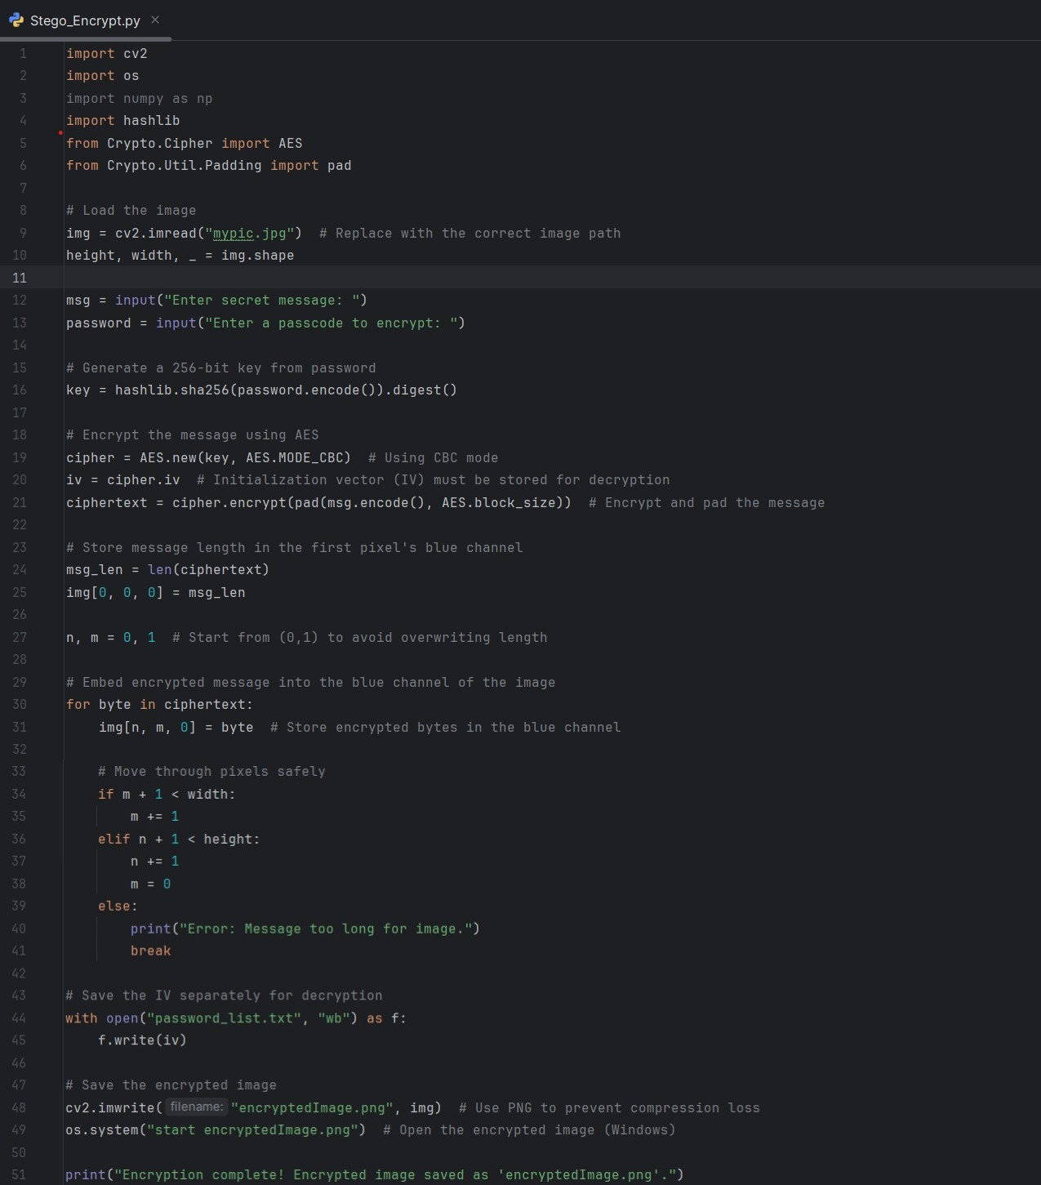

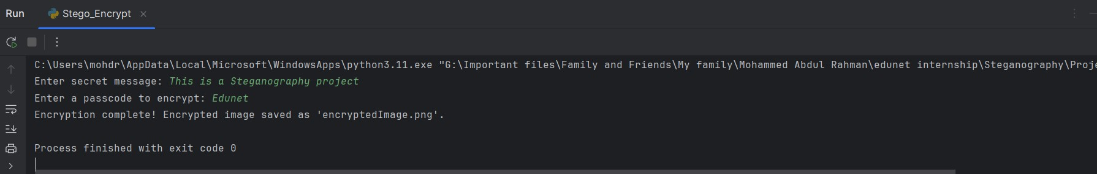
Results
Encryption Code
mypic.jpg
Output Console(Run)-Encryption

Slide 8
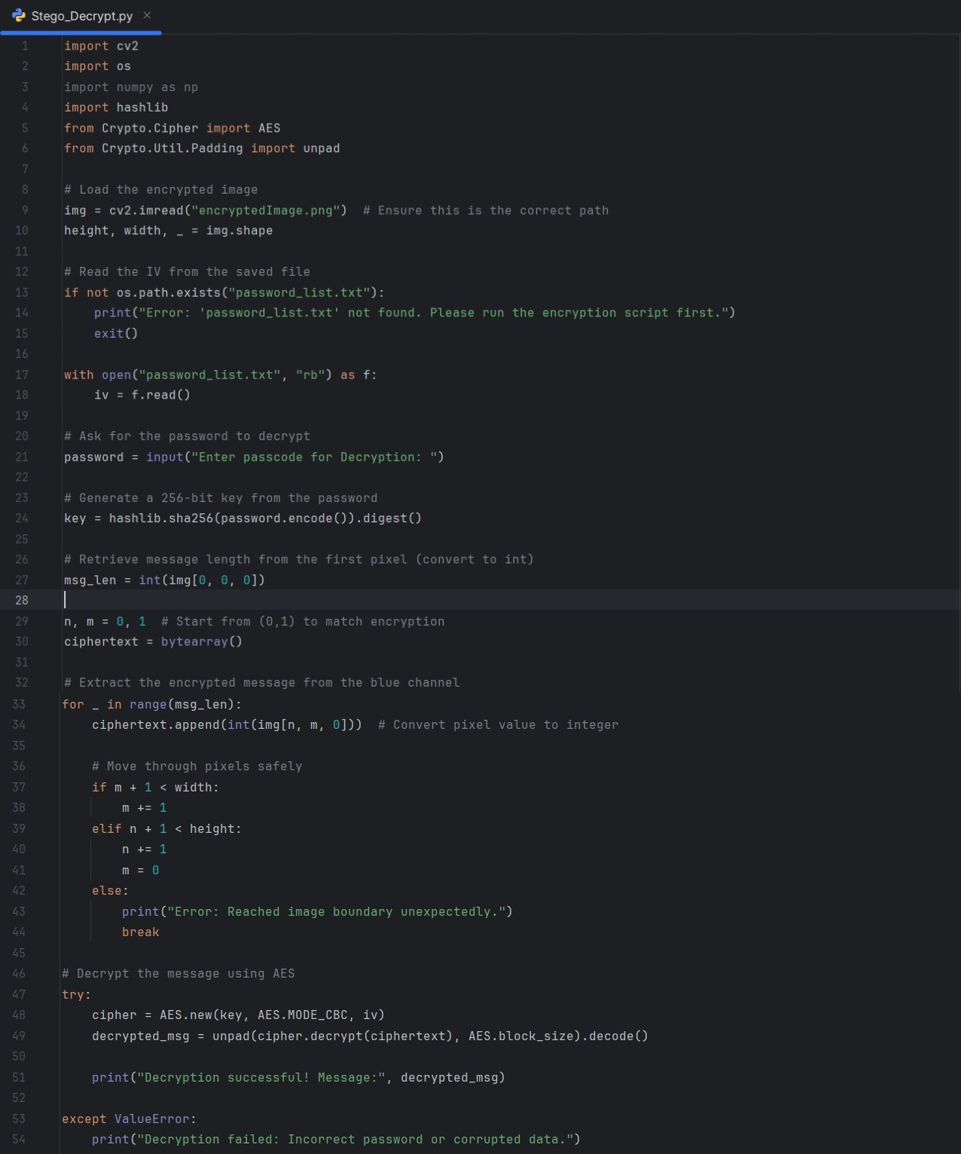

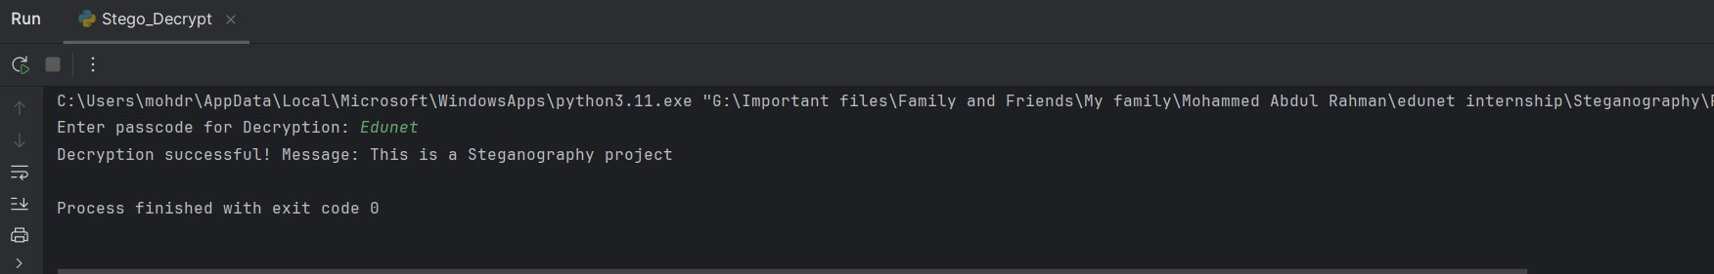
Results
encryptedImage.png
Decryption Code
Output Console(Run)-Decryption

Slide 9
Conclusion
With the increasing reliance on digital data, ensuring its security has become a critical concern. This project successfully implements a steganographic encryption and decryption method that enhances data protection by embedding encrypted messages within images. By combining AES encryption with steganography, the system ensures that sensitive information remains both hidden and securely encrypted, making it significantly harder for unauthorized entities to access or manipulate the data. This approach is particularly useful in domains like cybersecurity, defense, finance, and personal communications, where data confidentiality is of utmost importance.

Slide 10
GitHub Link
https://github.com/mohdrahman0056/Steganography-AICTE.git

Slide 11
Future scope(optional)
Integration with AI & Machine Learning – Enhancing steganography techniques using AI to improve security and concealment.
Quantum-Secure Encryption – Adapting encryption to withstand quantum computing threats for future-proof security.
Cross-Platform & Cloud Implementation – Expanding usability by integrating steganography in cloud storage and multi-platform applications.
Steganalysis Resistance – Developing countermeasures against advanced steganalysis techniques to make detection nearly impossible.
Real-Time Steganography – Implementing live encryption in video streams and communication systems for secure messaging.

Slide 12
THANK YOU

